Slide 1
Foundation of Software Testing Introduction
Prepared by: Jacek Okrojek, Rafał Nikiel
21 September 2015
Version: 1.0

Slide 2

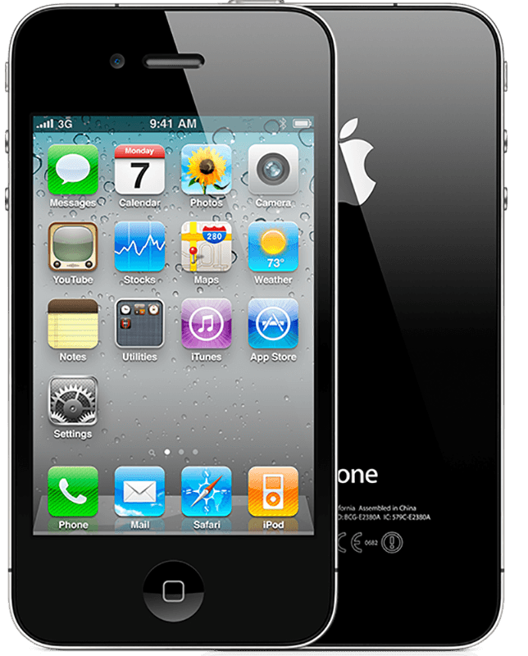
What those things have in common

Slide 3
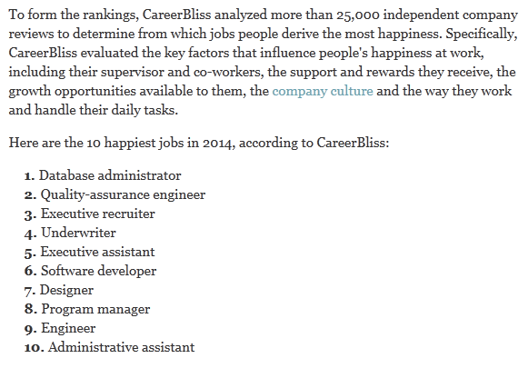
Testing as a profession
Most companies hire testers
Google and Microsoft event write a book about it
Most companies in Lodz hire testers
On demand testing
uTest
Testuj.pl
Open Source projects
Mozilla
Chromium
Sponsored projects
Play invites for mobile tests
You can test anything
References
http://testerzy.pl/baza-wiedzy/analiza-zarobkow-testerow-2015-czesc-ii
http://www.itjobswatch.co.uk/default.aspx?id=0&q=Test+Automation&l=

Slide 4
Testing Communities
Testing organizations
International Software Testing Qualification Board (ISTQB)
Association of Software Testing
Stowarzyszenie Jakości Systemów Informatycznych
Testing conferences
Google Test Automation Conference, Star Conferences
Testwarez
and many more
Testing Magazines and websites
Tea-time with testers
Testing Experience
Testerzy.pl
Qualele, Core
Testing events
Software Testing World Cup
Testing Cup Poland
Community meetings like: PtaQ, WrotQA, ŁódQA
References
http://testerzy.pl/baza-wiedzy/analiza-zarobkow-testerow-2015-czesc-ii
http://www.itjobswatch.co.uk/default.aspx?id=0&q=Test+Automation&l=

Slide 5
Few words about definitions
There are many schools of software testing
The different definitions reflect different visions of testing.
Meaning is not absolute. Words mean what the people who say them intend them to mean and what the people who hear them interpret them as meaning.
Clear communication requires people to share definitions of the terms they use. If you're not certain that you know what someone else means, ask them
Taken from http://testingeducation.org/BBST/foundations/BBSTFoundationsNov2010.pdf

Slide 6
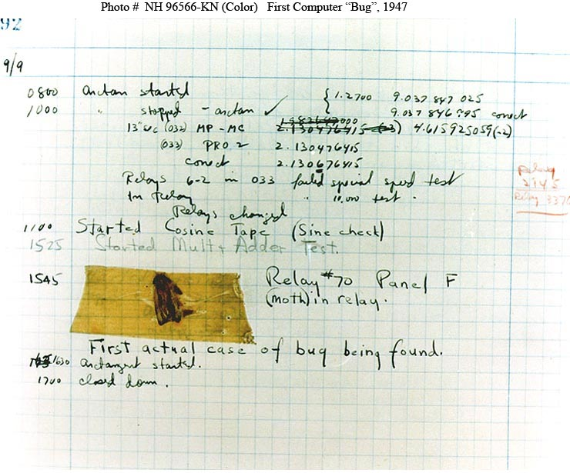
Bug
Used by Thomas Edison
Use of the term "bug" to describe inexplicable defects has been a part of engineering jargon for many decades and predates computers and computer software; it may have originally been used in hardware engineering to describe mechanical malfunctions. For instance, Thomas Edison wrote the following words in a letter to an associate in 1878:
It has been just so in all of my inventions. The first step is an intuition, and comes with a burst, then difficulties arise — this thing gives out and [it is] then that "Bugs" — as such little faults and difficulties are called — show themselves and months of intense watching, study and labor are requisite before commercial success or failure is certainly reached.[3]
The First "Computer Bug"
Moth found trapped between points at Relay # 70, Panel F, of the Mark II Aiken Relay Calculator while it was being tested at Harvard University, 9 September 1945. The operators affixed the moth to the computer log, with the entry: "First actual case of bug being found". They put out the word that they had "debugged" the machine, thus introducing the term "debugging a computer program". In 1988, the log, with the moth still taped by the entry, was in the Naval Surface Warfare Center Computer Museum at Dahlgren, Virginia.
Taken from https://en.wikipedia.org/wiki/Software_bug

Slide 7
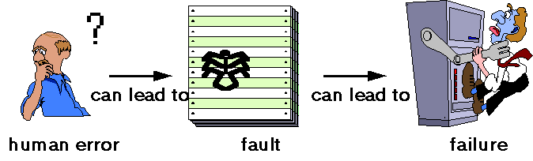
Bug, defect, error, failure, fault, mistake, quality, risk
A human being can make an error (mistake), which produces a defect (fault, bug) in the program code, or in a document. If defect in code is executed, the system may fail to do what it should do (or do something it shouldn't), causing a failure. Defects in software, systems or documents may results in failures, but not all defects do so.
Defects occur because human beings are fallible and because there is time pressure, complex code, complexity of architecture, changing technologies, and/or many system interactions.
Failures can be caused by environmental conditions as well. For example, radiation, magnetism, electronic fields, and pollution can cause faults in firmware or influence execution of software by changing the hardware conditions.

Slide 8
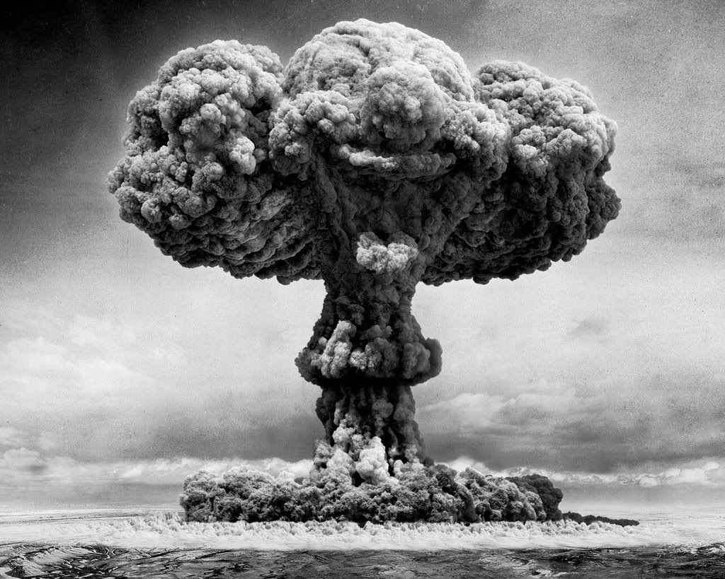
Any non-trivial program contains at least one bug
1985 -1987 – Therac - 25
1966 – Mariner 1
1991 – Dhahran
1996 – Ariane 5
1999 – Mars Climate Orbiter
1982 – Siberian pipeline sabotage
1983 – Serpukow-15
2014 – OpenSSL Heartbleed
2014 – Nabino
Notes:
28.07.1962: Mariner I – An error in a single FORTRAN statement resulted in the loss of the first American probe to Venus;
1985-1987: Several deaths of cancer patients were due to overdoses of radiation resulting from a race condition between concurrent tasks in the Therac-25 software.
1993: Division Algorithm (incomplete entries in a look-up-table) in Intel Pentium Processor; cost $475 000 000
1996 The Ariane 5 satellite launcher malfunction was caused by a faulty software exception routine resulting from a bad 64-bit floating point to 16-bit integer conversion; cost $500 000 000
2015 Polish presidential election
2015 HSBC system failure leaves thousands facing bank holiday without pay
References:
http://www.cs.tau.ac.il/~nachumd/verify/horror.html
http://www5.in.tum.de/~huckle/bugse.html
http://www.theguardian.com/money/2015/aug/28/many-hsbc-customers-facing-payday-without-pay

Slide 9
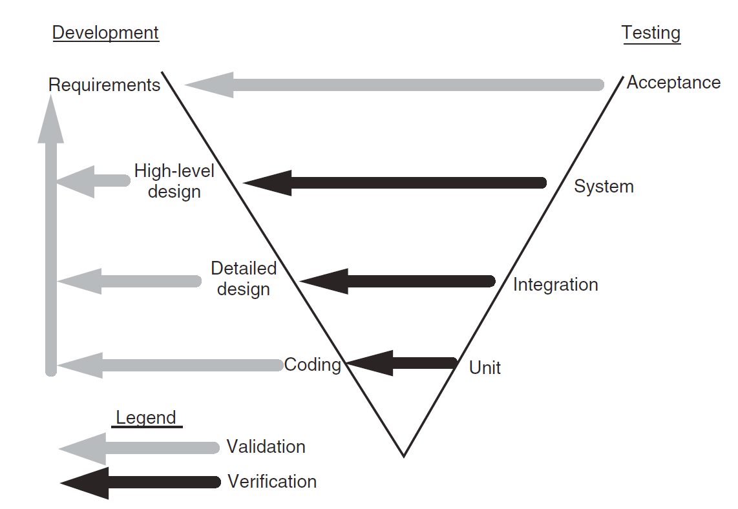
Test levels
Unit Tests
Individual units/components of a software/system are tested
The purpose is to validate that each unit of the software performs as designed
Integration Tests
Individual units are combined and tested as a group
The purpose of this level of testing is to expose faults in the interaction between integrated units
System Tests
Complete, integrated system/software is tested.
The purpose of this test is to evaluate the system’s compliance with the specified requirements
Acceptance Tests
System is tested for acceptability
The purpose of this test is to evaluate the system’s compliance with the business requirements and assess whether it is acceptable for delivery

Slide 10
Cost of bug at various test levels

Slide 11

Types of Tests
Functional Tests
Testing of Functions
Non-functional Tests
Testing of Non-functional Software Characteristics
Re-Tests & Regression Tests
Testing related to changes
Maintenance testing

Slide 12
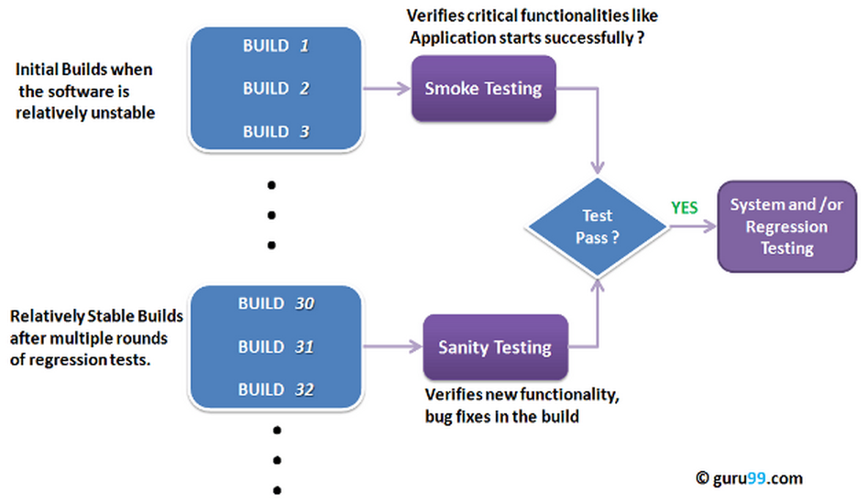
Functional Tests
Smoke and Sanity Tests

Slide 13
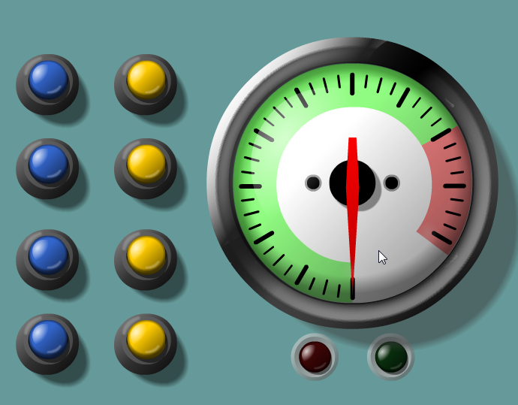
Functional Tests
Smoke and Sanity Tests
Exploratory Testing
http://blackboxpuzzles.workroomprds.com/Puzzle03.html
Notes:
http://blackboxpuzzles.workroomprds.com/Puzzle03.html

Slide 14
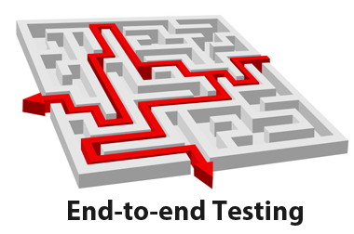
Functional Tests
Smoke and Sanity Tests
Exploratory Testing
End-to-end Testing

Slide 15

Functional Tests
Smoke and Sanity Tests
Exploratory Testing
End-to-end Testing
User Acceptance Tests - UAT

Slide 16
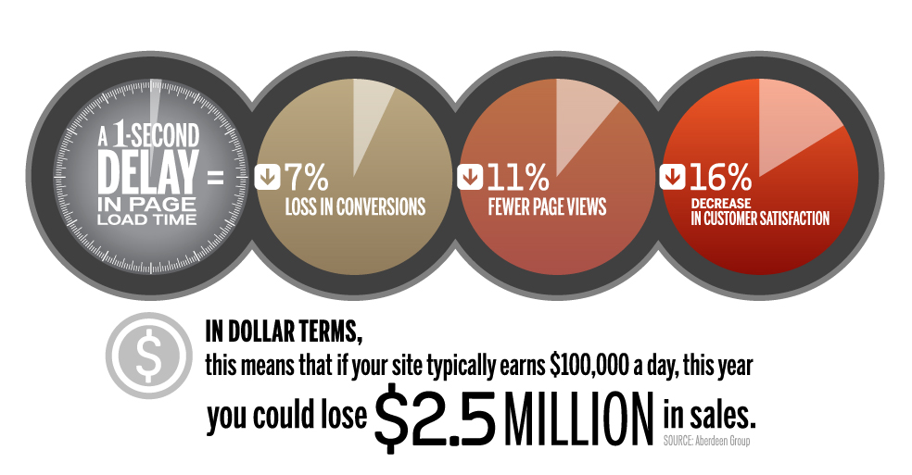
Non-functional Testing
What is non-functional testing?
In non-functional testing the quality characteristics of the component or system is tested.
Non-functional refers to aspects of the software that may not be related to a specific function or user action such as scalability or security (e.g. How many people can log in at once?)
Non-functional testing is also performed at all levels like functional testing.
Examples of non-functional tests:
Endurance, performance, stress, scalability, volume testing

Slide 17
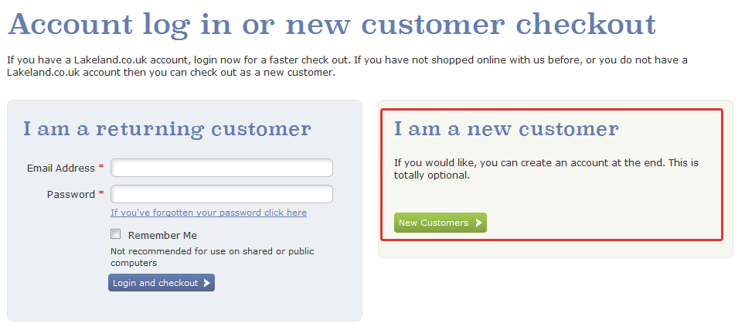
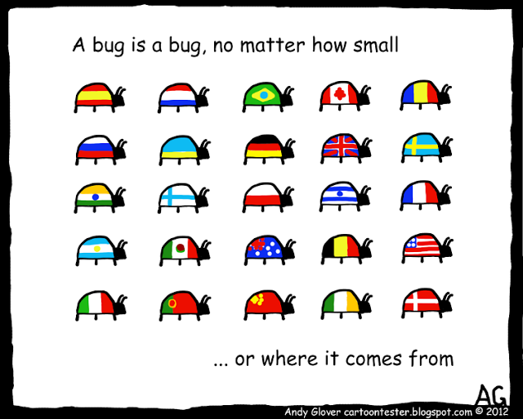
Non-functional Testing
Usability, accessibility testing
Internationalization testing and Localization testing
http://www.uie.com/brainsparks/2011/10/17/the-back-story-for-the-300-million-button/

Slide 18
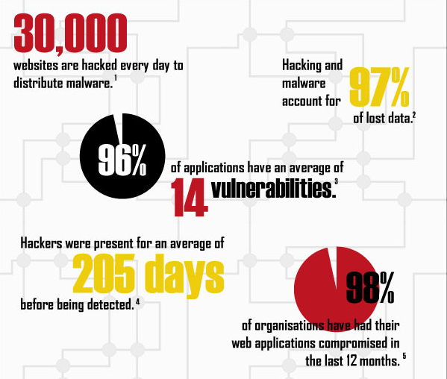
Non-functional Testing
Security testing

Slide 19
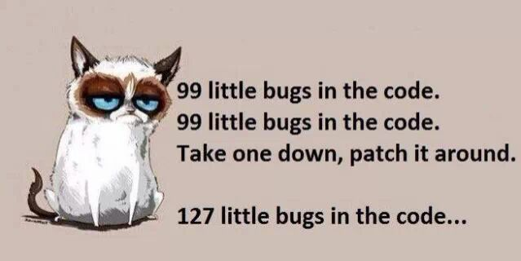
Regression Testing
What is regression testing?
The purpose of regression testing is to ensure that changes such as enhancements, patches or configuration changes have not introduced new faults.
Regression is usually good candidate for automation

Slide 20
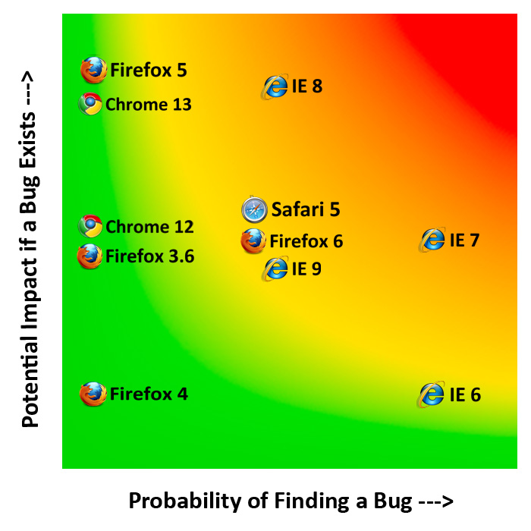
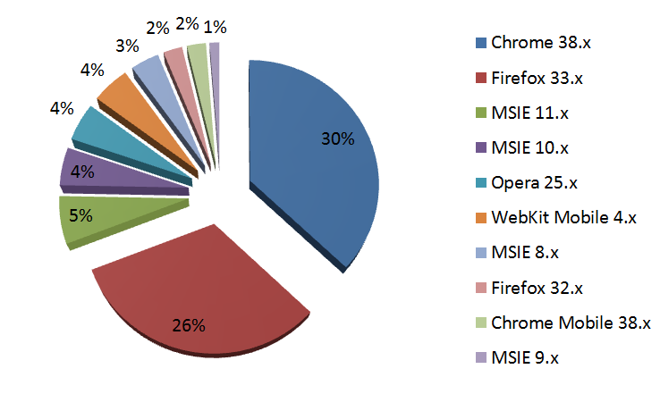
Risk Based Testing

Slide 21
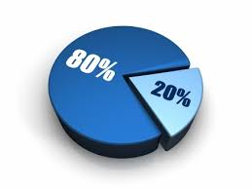
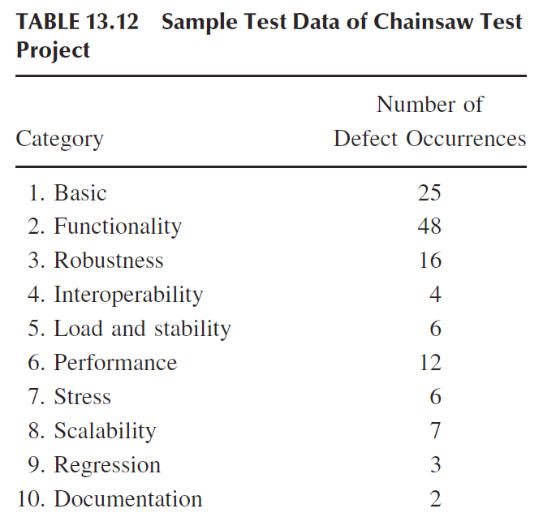
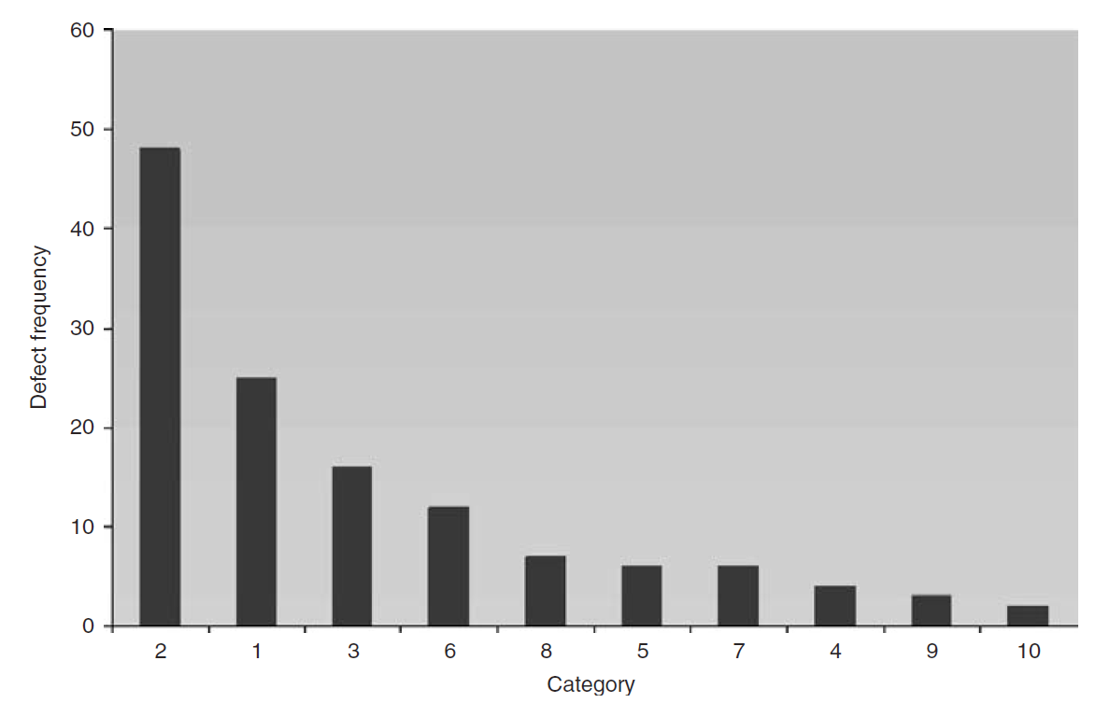
Pareto principle
The Pareto principle (also known as the 80–20 rule, the law of the vital few, and the principle of factor sparsity) states that, for many events, roughly 80% of the effects come from 20% of the causes.
80% of a company's profits come from 20% of its customers
Example in software testing
Microsoft noted that by fixing the top 20% of the most reported bugs, 80% of the errors and crashes would be eliminated. Any developers dream would to write a bug-less code, but in reality, this can’t happen.

Slide 22
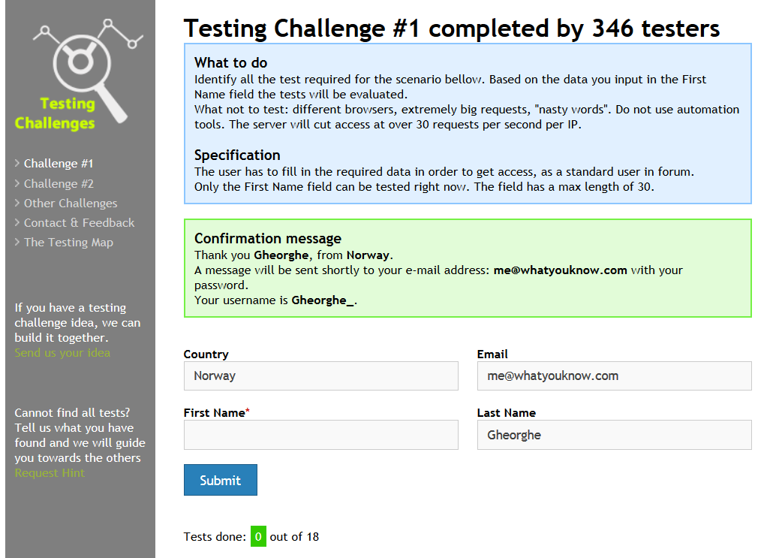
Testing techniques
Black Box or Specification based techniques
The tester designs tests from his (research-based) knowledge of the product's user characteristics and needs, the subject area being automated (e.g. “insurance”), the product's market, risks, and environment (hardware / software). Some authors narrow this concept to testing exclusively against an authoritative specification.
Notes:
http://testingchallenges.thetestingmap.org/index.php
https://www.owasp.org/index.php/XSS_Filter_Evasion_Cheat_Sheet

Slide 23
Testing techniques
White Box or Structure based techniques
Testing or test design using knowledge of the details of the internals of the program (code and data). White Box testers typically ask “Does this code do what the programmer expects or intends?” in contrast to the black box question: “Does this do what the users (human and software) expect?”
public ActionResult Contact(bool ShowMessage = false)
{
var model = new ContactView();
var userId = User.Identity.GetUserId<int>();
var customer = db.Customers.SingleOrDefault(x => x.AccountUserId == userId);
if(customer != null)
{
var user = db.User.SingleOrDefault(x => x.Id == customer.UserId);
if(user != null)
{
model.UserId = user.Id;
model.FullName = user.FullName;
model.Email = user.Email;
model.PhoneNumber = user.PhoneNumber;
}
var inquiries = db.Inquiries.
LeftOuterJoin(db.InquiryUsers, a => a.Id, b => b.InquiryId, (a, b) => new { a, b }).
Where(x => x.b != null && x.a.UserId == user.Id).
Select(s => s.b).Distinct().ToList();
var otherUsers = inquiries.Select(x => x.User).
Distinct().ToList();
ViewBag.OtherUsers = otherUsers;
}
ViewBag.ShowMessage = ShowMessage;
GetLists();
return View(model);
}
Notes:
http://testingchallenges.thetestingmap.org/index.php
https://www.owasp.org/index.php/XSS_Filter_Evasion_Cheat_Sheet

Slide 24
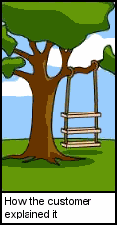
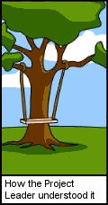
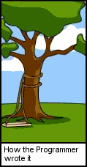
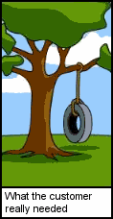
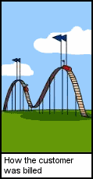
Quality
Distance between the actual object under test and the customer's expectation of the object
How we can improve quality?
Testing does not improve quality
Quality comes from improvement of development process

Slide 25
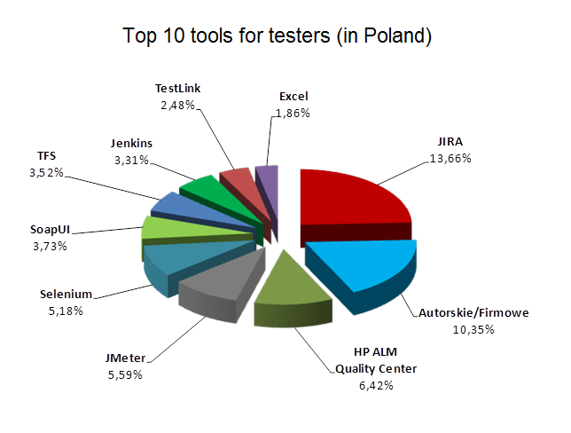
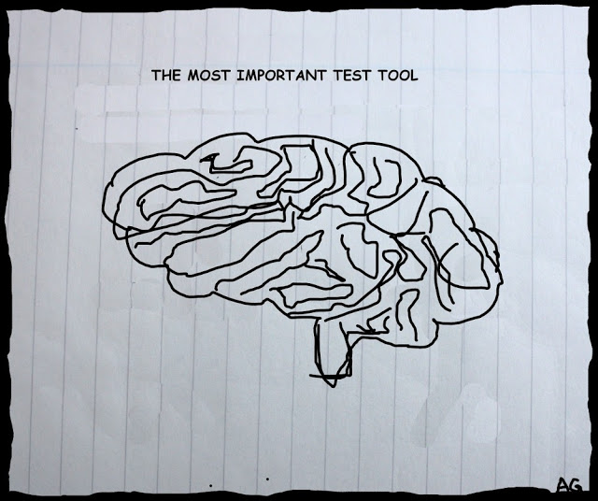
Toolkit
Notes:
http://testerzy.pl/baza-wiedzy/narzedzia-w-pracy-testera-wyniki-ankiety

Slide 26
Seven testing principles
Testing shows presence of defects
Testing can show that defects are present, but cannot prove that there are no defects. Testing reduces the probability of undiscovered defects remaining in the software but, even if no defects are found, it is not a proof of correctness
Exhaustive testing is impossible
Testing everything (all combinations of inputs and preconditions) is not feasible except for trivial cases. Instead of exhaustive testing, risk analysis and priorities should be used to focus testing efforts.
Early testing
To find defects early, testing activities shall be started as early as possible in the software o system development life cycle, and shall be focused on defined objectives.
Defect clustering
Testing effort should be focused proportionally to the expected and later observed defect density of the module. A small number of modules usually contains most of the defects discovered during pre-release testing, or is responsible for most of the operational failures.
Pesticide paradox
If the same tests are repeated over and over again, eventually the same set of test cases will no longer find any new defects. To overcome this "pesticide paradox", test cases needs to be regularly reviewed and revised, and new and different tests need to be written to exercise different parts of the software or system to find potentially more defects.
Testing is context dependent
Testing is done differently in different contexts. For example, safety-critical software is tested differently from an e-commerce site.
Absence-of-error fallacy
Finding and fixing defects does not help if the system built is unusable and does not fulfil the users' needs and expectations.

Slide 27
Program of the course
Software Testing Foundations
Introduction to testing
White box testing techniques
Black box testing techniques
Manual functional testing
Scripted test
Exploratory test
Automated Functional Testing
General ideas and approaches
Selenium
JMeter
Non-functional Testing
Performance Testing
Security Testing
Usability Testing
Test Management
Documentation and Test Management
Requirements

Slide 28
How to pass
Presence
You are allowed to up to 3 absences
Home works
Exam at the end (maybe)

Slide 29
Recommended knowledge sources and references
Cerified Tester Foundation Level Syllabus
Testing Education
The Art of Software Testing by Glenford J. Myers and Corey Sandler
Agile Testing: A Practical Guide for Testers and Agile Teams by Lisa Crispin and Janet Gregory

Slide 30
Thank you!

